Slide 1
Introduction to the Online IEP Quality Tutorial Professional Development Resource
Susan Carty – scarty@Illinois.edu
&
Jim Shriner – jshriner@Illinois.edu
University of Illinois
SELA
Lunch and Learn
April 19, 2023
Preparation of this presentation was supported, in part, by awards (R324J060002, R324A120081) from the U. S. Department of Education, Institute of Education Sciences, National Center on Special Education Research, and from the Illinois State Board of Education (Part B-Discretionary Programs) awarded to the author. Opinions expressed herein do not necessarily reflect those of the U. S. Department of Education or ISBE.
Notes:
1

Slide 2
The IEP Quality Project is supported, in part, by funding from the Illinois State Board of Education (Part B-Discretionary Programs) and all content is subject to copyright.
Opinions expressed herein are not to be considered legal advice and do not necessarily reflect opinions of the Illinois State Board of Education or Offices within it.
Notes:
Required legal slide:

Slide 3
IEPs must be internally consistent
PLAAFP Statement
Measurable Annual Goals
Special Education Services
Monitoring Progress
Determination of Needs: Specially-Designed Instruction / Accommodations
Source: Shriner, J.G., Bateman, D.F., & Yell, M.L., (2021, February). IEPs in the Era of Endrew F. : Writing Appropriate Present Levels Statements. Virtual Presentation to the 99th Annual Conference of Exceptional Children Conference.

Slide 4
One component/decision must lead directly to the next
Internal consistency assures that:
All needs identified in the PLAAFP are addressed either through Specially-designed instruction (SDI), Accommodations, or both.
“Rogue” goals for SDI for which no need is documented are avoided
Students are neither “under-accommodated” nor “over-accommodated”
Services and supports are linked logically to PLAAFP/needs
Data from evaluation and progress monitoring are used to examine the IEP’s appropriateness on a regular basis

Slide 5
Research Support:
Impact and User Feedback

Slide 6
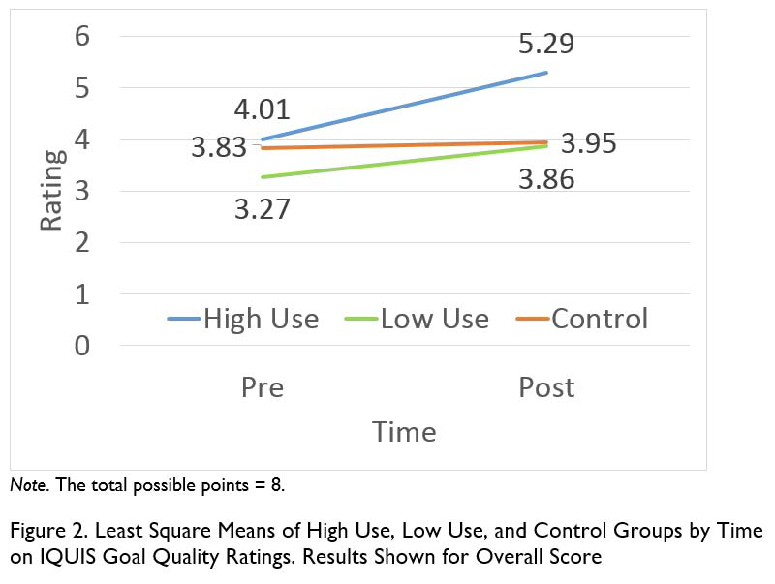
Change in Teachers’ Practices – Goal Quality Scores

Slide 7
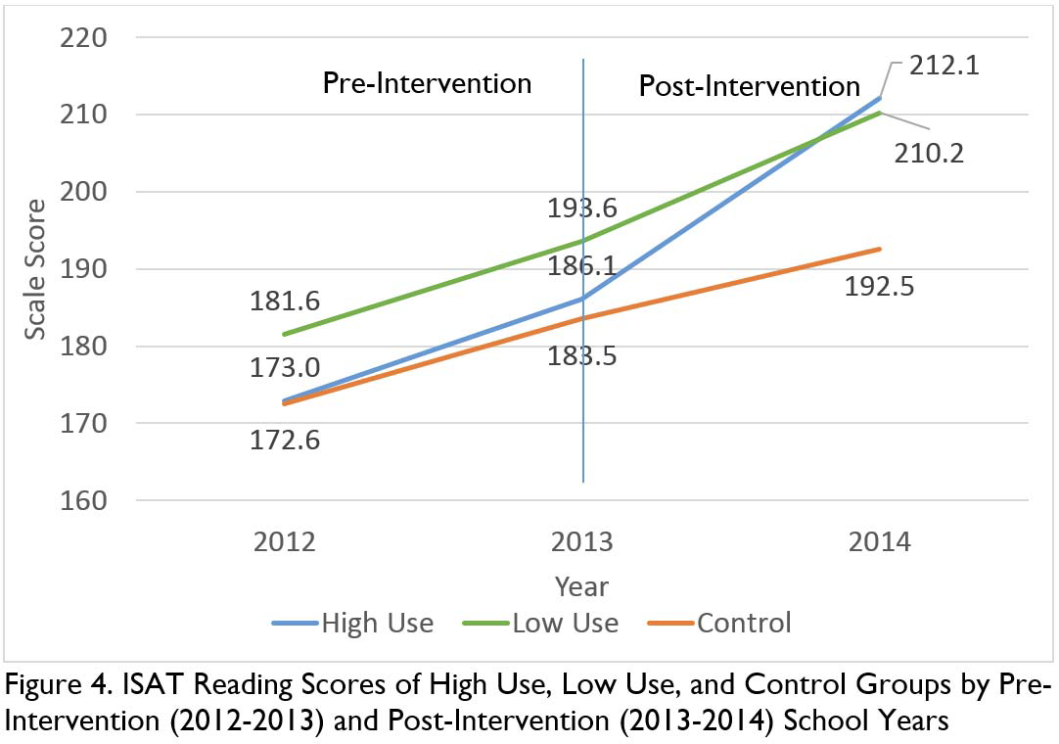
Change in Student Outcomes –
Students of
“High Use” teachers had steeper slope of change

Slide 8
- Overall, there is a goldmine of information! When I’ve attended one day workshops addressing changes in IEPs, I’ve felt overwhelmed by having all of the info thrown at me at once. Having this site available to access at my leisure and when it is needed is wonderful!
- It made me think about my kids on a deeper level
-I have been known to be nervous during IEP meetings knowing the goals, objectives, and present levels may be less than adequate. I now have confidence in the IEP and know it is a quality (IEP).
- I think I was on the right track, but this helped to solidify the proper way and most useful way to write goals and objectives that are measurable and realistic
- Because my goals are more in-depth my assessments for next year will be more student centered to focus on achieving the individual goals and objectives
User Feedback

Slide 9
- I had a couple of parents say that the goals were more clear and easier to understand
- Parent IEP Planning sheet was very helpful. In the past, I feel parents are many times unprepared to discuss concerns about the pupil because they haven’t really given it much thought. It helps parents be prepared better for the IEP.
- They (gen ed staff) love it because they feel such a larger part of the IEP now, where before it’s like it was the special ed. team that was developing the goals.
- I think it opened the eyes of the [gen. ed.] teachers too, in understanding even though this student is on an IEP, they still need to perform at the grade standard.
Increased input / “buy-in” by parents and general education staff in IEP process

Slide 10
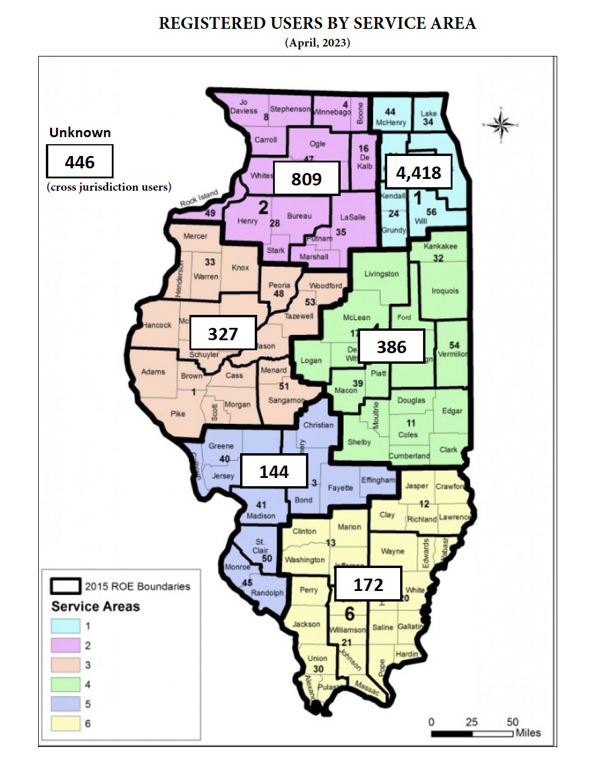

Slide 11
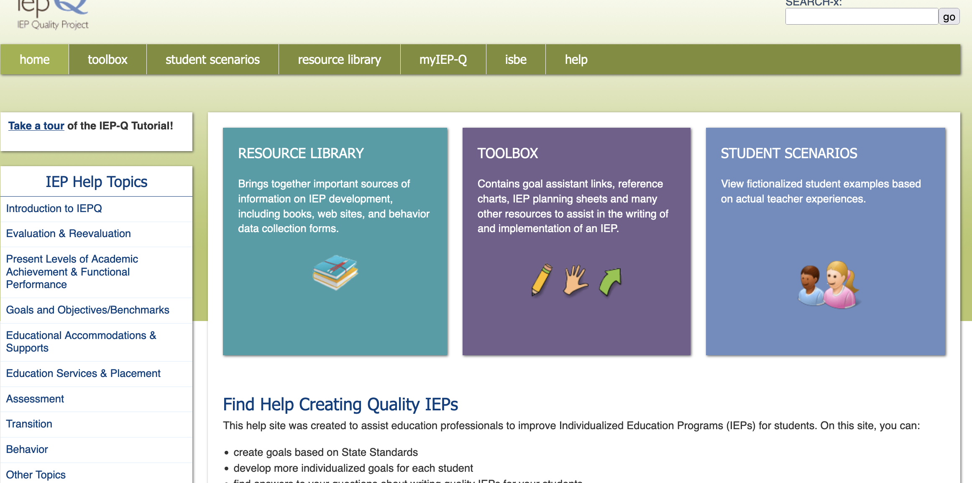
IEPQ Website
https://iepq.education.illinois.edu

Slide 12
IEPQ Website
https://iepq.education.illinois.edu
Registering
https://iepq.education.illinois.edu/user/register-illinois
Toolbox
Resource Library
Student Scenarios / Sample IEPs
Help Topic Pages
PLAAFP
Goals and Objectives pages
Help section
(videos that take you through IEPQ and the Goal Assistant programs)

Slide 13
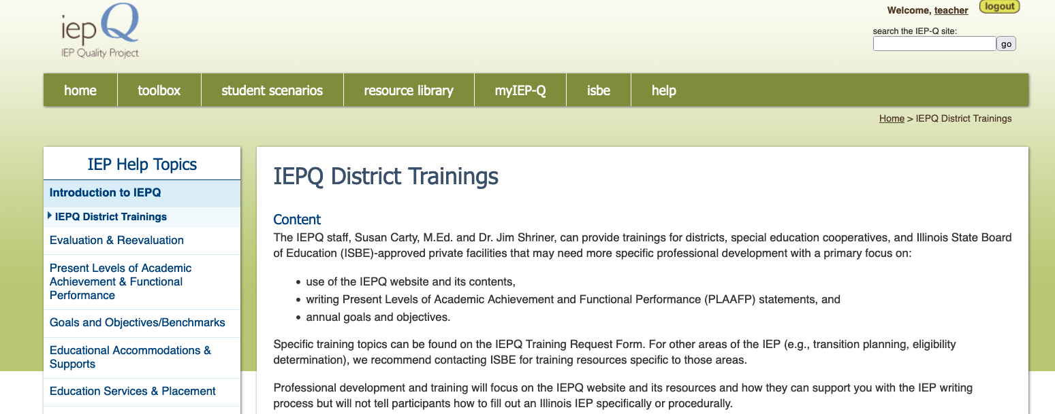
IEPQ Trainings for Districts
More information about the training available for districts through IEPQ can be found on the IEPQ website in the Introduction to IEPQ Help Topic page: https://iepq.education.illinois.edu/help-topics-book/iepq-district-trainings

